Slide 1
GOOD NEWS.
GREAT JOY!
OPERATION CHRISTMAS CHILD
Notes:
Slide time: 3 Minutes
Welcome the attendee(s)
Introduce yourself
Open the session in prayer

Slide 2
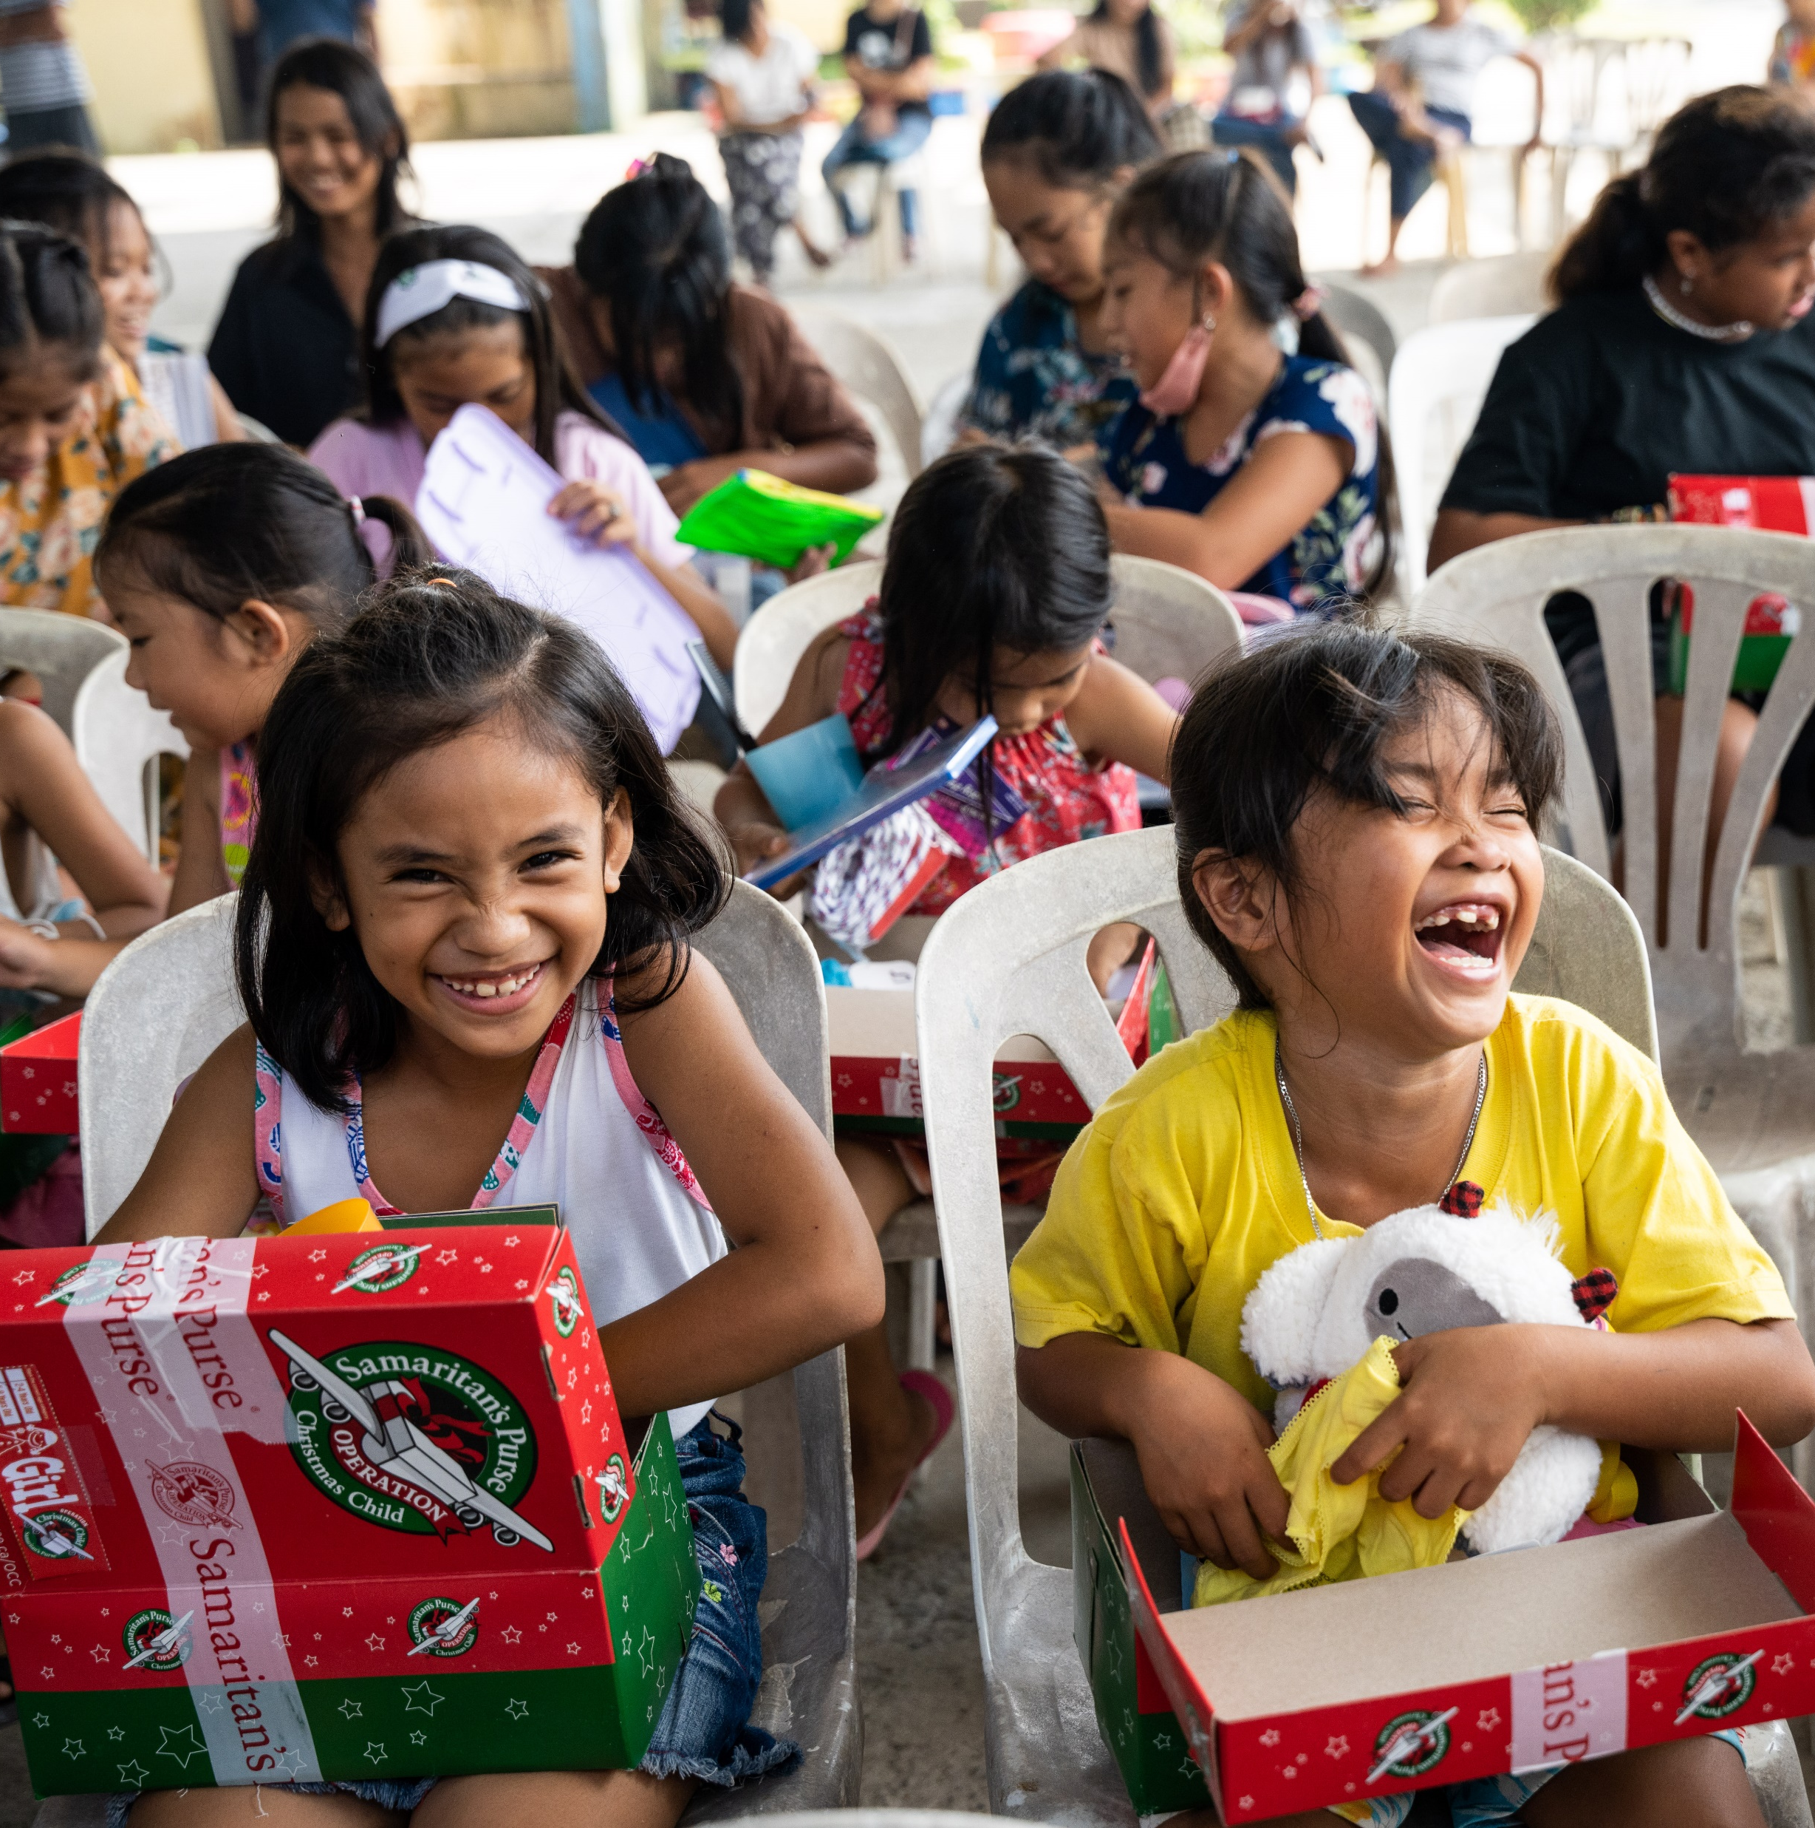

MISSION
STATEMENT
The mission of Operation Christmas Child is to demonstrate God’s love in a tangible way to children in need around the world and together with the local church worldwide, to share the Good News of Jesus Christ.
Notes:
Slide time: 1 minute
Operation Christmas Child is the world’s largest Christmas project of its kind, sending millions of gift-filled shoeboxes across the globe each year.
OCC demonstrates God’s love in a tangible way to children in need around the world.
Together with the local church worldwide, each shoebox gift is an opportunity to share the Good News of Jesus Christ.

Slide 3
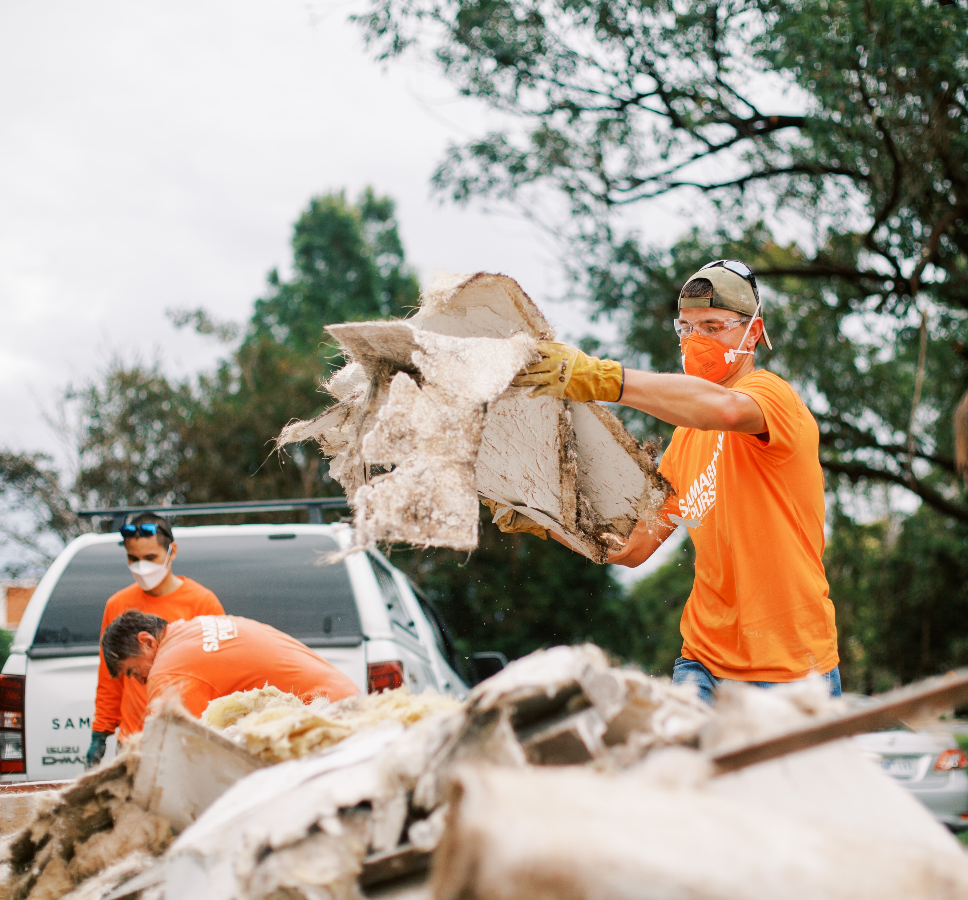
SAMARITAN’S
PURSE
  Crisis and Disaster Response
  Education
  Health and Medical
  Animals, Agriculture & Livelihoods
  Water, Sanitation & Hygiene
  Operation Christmas Child
Notes:
Slide time: 1 minute
Operation Christmas Child is the largest project of Samaritan’s Purse.
Samaritan’s Purse Australia and New Zealand responds to physical and spiritual needs of individuals in crisis situations – especially in locations where few others are working. Samaritan’s Purse works in more than 100 countries to provide aid to victims of war, disease, disaster, poverty, famine and persecution. For more information, visit SamaritansPurse.org.au
Samaritan’s Purse is led by President and CEO Franklin Graham.
You can see a snapshot of other programs and impact of Samaritan’s Purse on this slide.

Slide 4
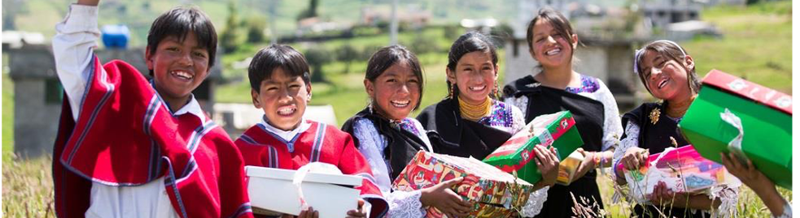
THE GREAT
COMMISSION
Matthew 28:19-20
“Therefore, go and make disciples of all nations, baptising them in the name of the Father and of the Son and of the Holy Spirit, and teaching them to obey everything I have commanded you. And surely, I am with you always, to the very end of the age.”
WHY A SHOEBOX GIFT?
Notes:
Slide time: 2 minutes
• So, you may wonder, why a shoebox gift?
• It all stems from Jesus’s command in Matthew 28:19-20, or what we refer to as the Great Commission.
• Read verses
• Operation Christmas Child uses a shoebox gift as a tool to open the door for the Gospel and make disciples of all nations.
• As it says in Proverbs 18:16 “A gift opens the way for the giver and ushers him into the presence of the great.” (NIV)
• God takes the simple gift and multiplies it in a way only He can, for tremendous Kingdom Impact.
• I’m excited to share with you today how these gifts are changing the eternal destinies of millions of children and their families each year.

Slide 5
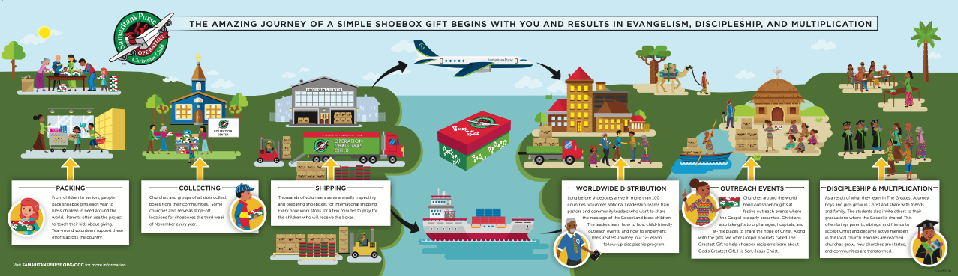
THE JOURNEY OF
A SHOEBOX
Notes:
Slide Time: 2 minutes
Operation Christmas Child starts right here with you!
First, year-round volunteers in Australia and New Zealand share about Operation Christmas Child and invite people to be involved.
Individuals, families, groups and churches collect items throughout the year to fill shoebox gifts.
Then, we pack our shoeboxes with toys, school supplies, hygiene items, letters/photos and most importantly, prayer.
Next, during National Collection, we deliver our shoebox gifts to a Central Drop-off or Drop-Off Location near us. Last year, there were hundreds of Drop-Off Locations across Australia and New Zealand!
Our shoeboxes are then transported to Processing Centers within Australia and New Zealand, where they are prepared for international shipping.
Shoeboxes then make the long journey to their destination country. Gifts travel to more and more countries and territories each year, including hard-to-reach countries that are not named for security reasons.
Shoeboxes are transported by various means, including boats, airplane and trucks. Once in country, they are sometimes transported by camel, yaks, or even elephants!
Finally, through the partnership of National Leadership Teams, Ministry Partners are equipped to share the Gospel in a child-friendly way and place our shoeboxes in the hands of precious children.

Slide 6
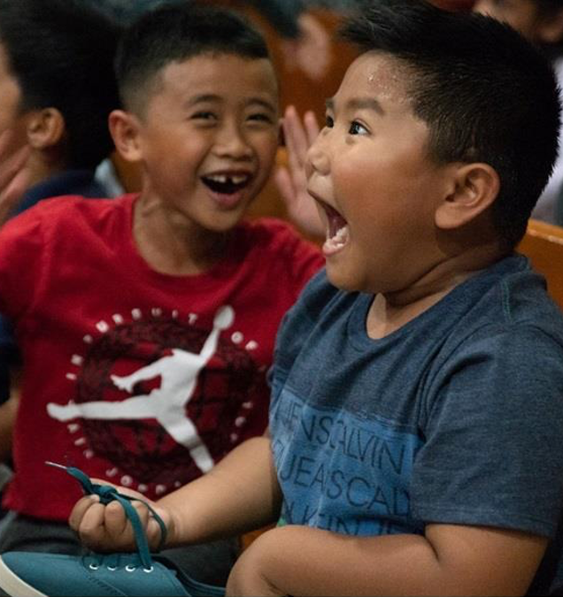
GOD IS MULTIPLYING GOOD NEWS AND GREAT JOY!
AS YOU... PRAY
AS YOU... PACK
AS YOU... PARTNER
Notes:
Slide time: 1-4 minutes
How have you been involved with Operation Christmas Child?
* Affirm their answers and thank them for their important part in sharing God’s love with precious children. If in a large group setting, choose a few people to respond.
God is using each of us through this ministry to powerfully impact the world!
God is using our prayers to open doors for Ministry Partners around the world to share Jesus, disciple new believers and grow the local church.
God is mobilising individuals, families, churches, community groups and students to pack more shoeboxes so more children have the opportunity to respond to Jesus.
And, God is raising up people right here to partner on the year-round team to engage even more people to be hands-on with the Great Commission through this Ministry. We will talk about that more in just a bit!
Through you, God truly is multiplying Good News and great joy!

Slide 7
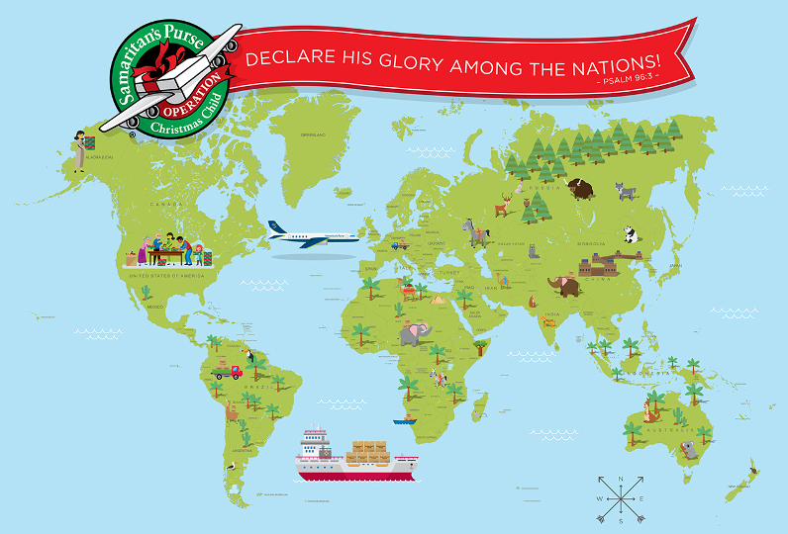
Notes:
Slide time: 2 minutes
Operation Christmas Child has had an incredible global impact!
Operation Christmas Child has been collecting gift-filled shoeboxes since 1993.
Several countries around the world collect shoeboxes every year.
In these years, more than millions of shoeboxes have been received and distributed to hundreds of countries and territories!
For many of the children receiving these shoeboxes, this is the first gift they have ever received. This opens their heart to God’s love and the Gospel. Because these children share the message that they’ve received, each shoebox gift has the potential to impact as many as 10 people with the message of hope and redemption.

Slide 8
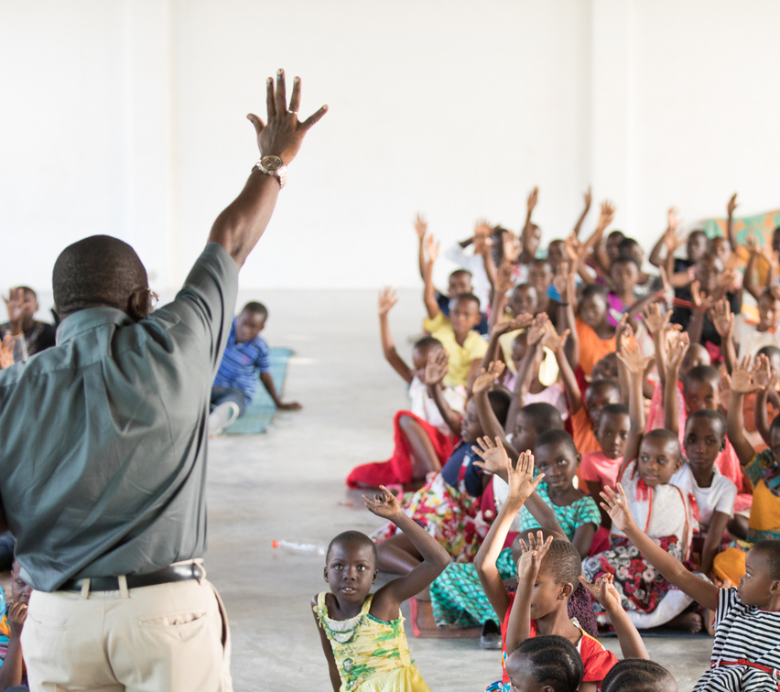
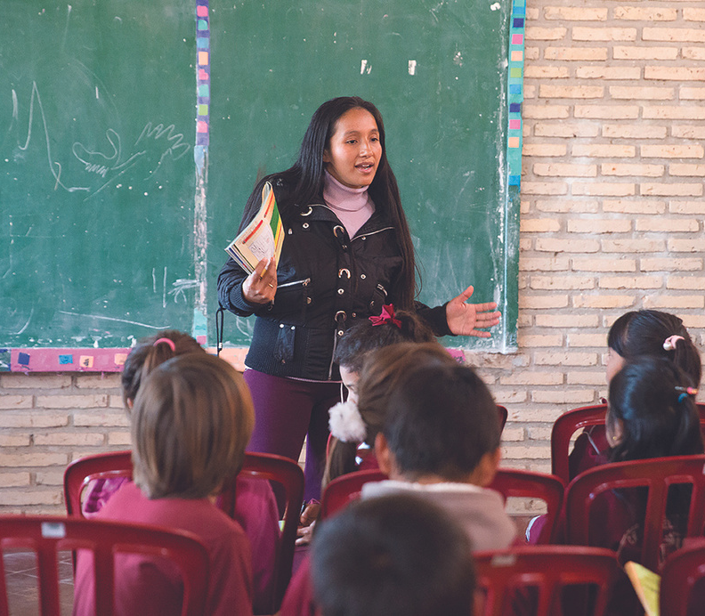
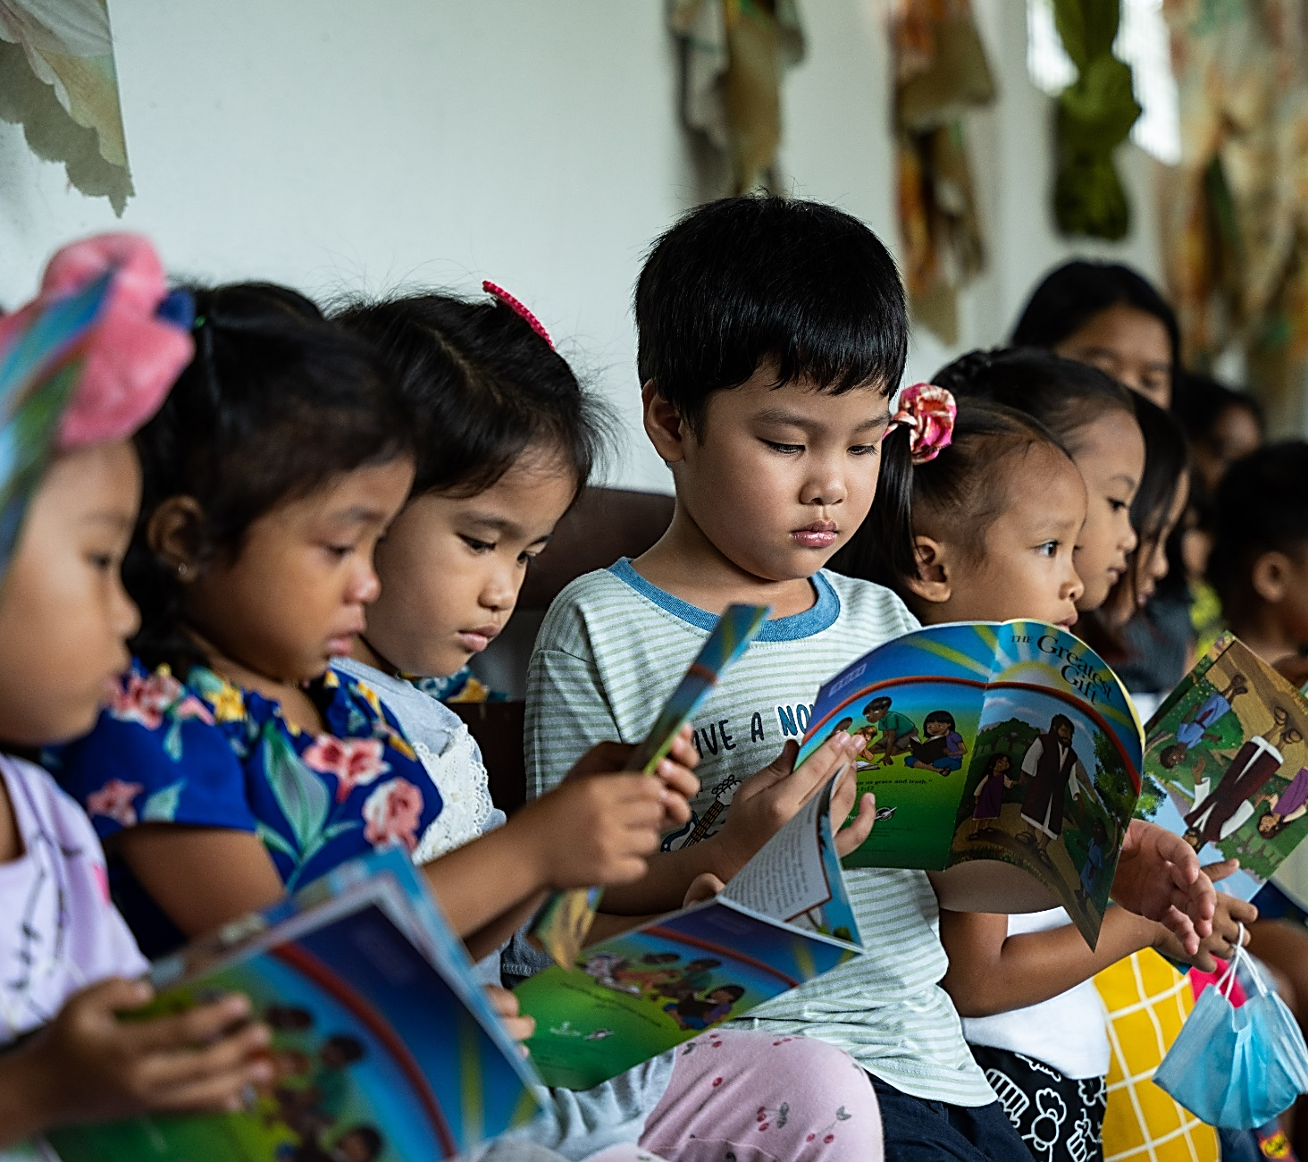
OPERATION CHRISTMAS CHILD IS ALL ABOUT...
EVANGELISM
DISCIPLESHIP
MULTIPLICATION
Notes:
Slide time: 1 minute
Operation Christmas Child is all about Evangelism, Discipleship and Multiplication!
Children and their families and friends are being introduced to Jesus.
They are then being discipled to become disciple makers!
As a result, the Gospel is being multiplied and the church worldwide is strengthened!
First, Operation Christmas Child is focused on evangelism and reaching children with the message of the Gospel. In fact, we will often call shoeboxes GO Boxes –for G-Gospel O-Opportunity!

Slide 9
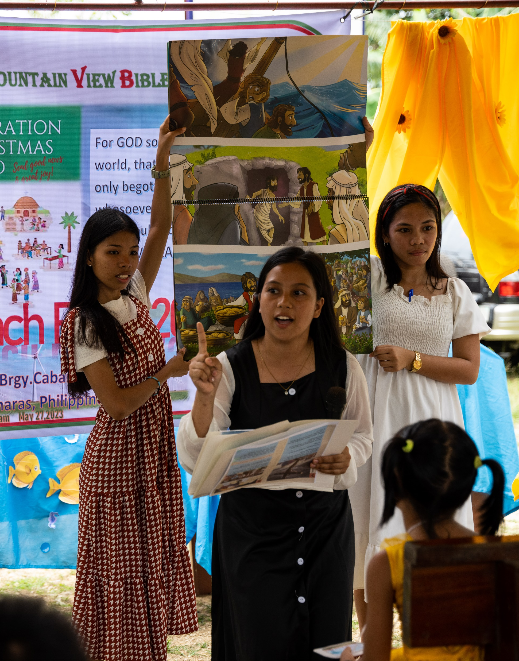
EVANGELISM
THE GOSPEL IS SHARED AT MANY OUTREACH EVENTS EACH YEAR!
Notes:
Slide time: 3 minutes
When locally trained Ministry Partners gather children together for a shoebox outreach event, the first priority is Evangelism and sharing the Gospel.
Using the Ministry Partner Guide, the Gospel is presented in a child-friendly way with colorful pictures, tracing creation to the cross. (show the guide)
Children are invited to receive Jesus, and are led through a simple prayer of commitment.
And that is BEFORE shoeboxes are ever passed out!
Then, boys and girls receive a surprise – a shoebox gift that is a tangible expression of the love of God that they have just heard about – for many their first gift ever.
Thousands of shoebox outreach events happen around the globe in numerous countries every year.

Slide 10
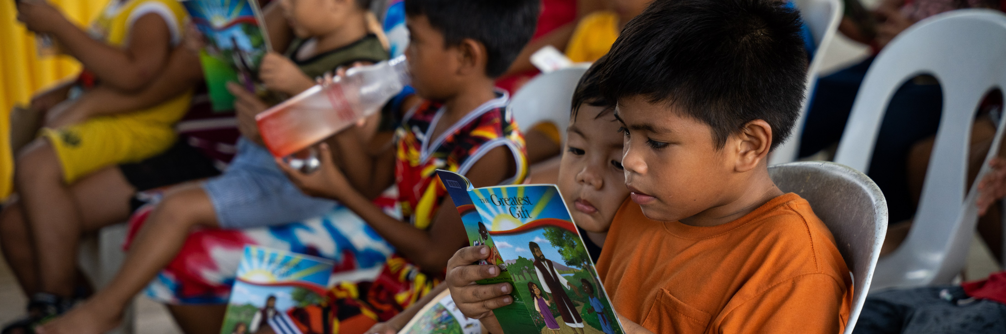

THE GREATEST GIFT
EVANGELISM
Notes:
Slide time: 1 minute
When a shoebox gift is placed in the hands of the child God has chosen, Ministry Partners put a booklet called The Greatest Gift on top of the shoebox (Show The Greatest Gift booklet).
The Greatest Gift walks a child through the Gospel again, and is a book they can take home and share with their family and friends.
The Greatest Gift is printed in a multitude of languages, with more translations in progress.
This beautiful, colorful booklet is often poured over by the children, and reinforces that they are loved by God, and He has a plan for their life.
The Greatest Gift showcases The Greatest Gift of All: Jesus!

Slide 11
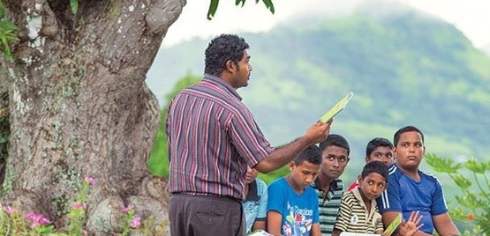
DISCIPLESHIP
THE GREATEST JOURNEY
12-Week Discipleship Program
Notes:
Slide time: 4 minutes
After a child hears the Gospel and receives their shoebox gift, which is Evangelism, Operation Christmas Child focuses on Discipleship, teaching children how to know Christ and grow in their faith.
The Greatest Journey is the follow-up program to the shoebox outreach event. It is one of the largest discipleship programs in the world.
After receiving shoebox gifts, many children are invited to come back and participate in The Greatest Journey Discipleship Program.
The Greatest Journey is a 12-lesson Bible study that teaches students how to follow Christ and share Him with others. They learn Bible stories, memorize verses and participate in activities. The lessons are about coming to know Christ, growing in faith, and sharing their faith with others.
The Greatest Journey was started several years ago and continues to make an impact on millions of children around the world who have enrolled in this Discipleship Program!
The Greatest Journey is also raising up a multitude of ministry leaders who are trained to share the Gospel and disciple children.
Most of the churches we partner with have never received formal training on how to disciple children, nor have they ever had children's materials until Operation Christmas Child.
Through OCC training with The Greatest Journey, teachers are equipped to apply Bible stories to students’ lives and encourage students to retell the stories to others.
The Greatest Journey Leader Guide, as well as the teacher training, allows for low-literacy cultures to participate. This equips teachers to continue discipleship lessons with their students long after they complete the workbook.
So far, over a million teachers in various countries have been trained by Samaritan’s Purse to lead The Greatest Journey, and make disciples! The numbers of trained disciple-makers continues to grow and changes from year to year.

Slide 12
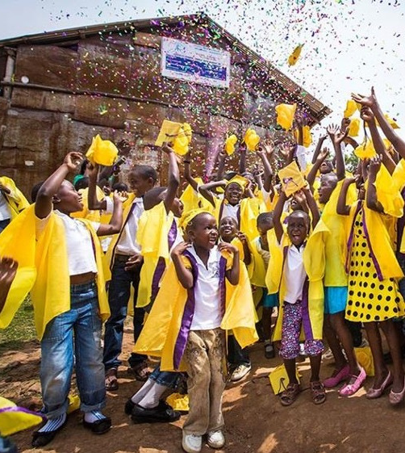
THE GREATEST JOURNEY GRADUATION
GIVEN A CERTIFICATE AND BIBLE
THE GOSPEL IS SHARED WITH FRIENDS AND FAMILY
MILLIONS OF CHILDREN HAVE GRADUATED
MILLIONS OF CHILDREN HAVE MADE DECISIONS FOR CHRIST
Notes:
Slide time: 1 minute
After completing The Greatest Journey, children attend a graduation celebration and receive a certificate and a New Testament Bible in their own language.
Some National Leadership Teams purchase caps and gowns to share across their country to celebrate this accomplishment. This may be the only graduation a child ever experiences.
Family and friends who attend the ceremony hear the Gospel presented at the graduation of their loved one, reinforcing the changes they have seen in the student’s lives.
Families often come to faith in Christ as a result.
In many cases, the Bible the child receives is the first copy of God’s Word to enter the household, and children read through their Bible again and again.
The Greatest Journey Discipleship Program is reaping a tremendous harvest across the globe!
Several million children have graduated from The Greatest Journey since the program began, and more than a million children have made decisions to follow Christ!

Slide 13
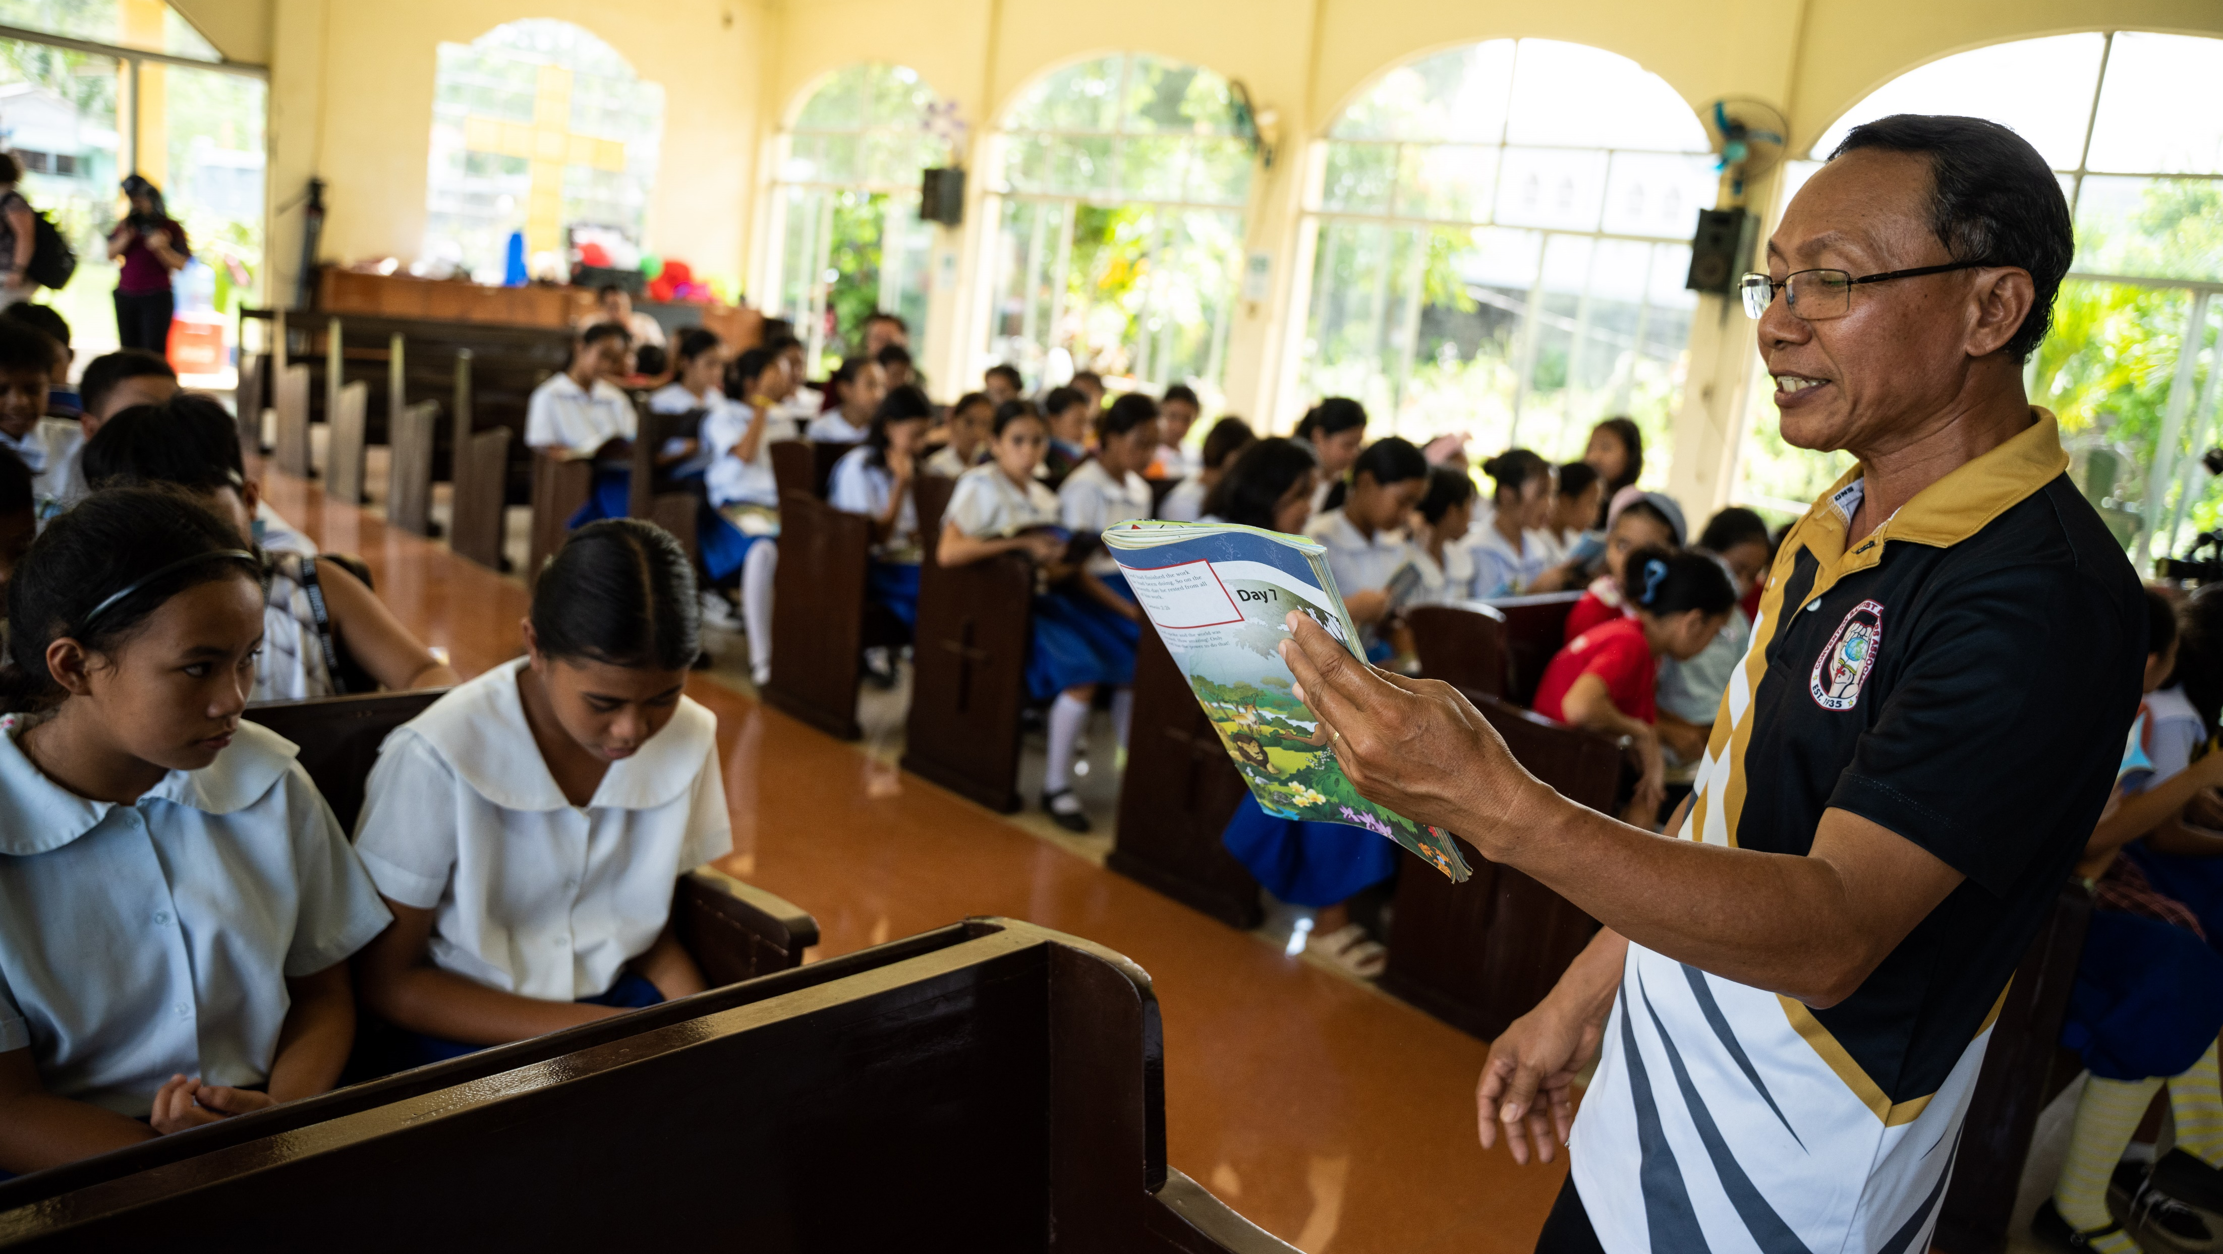
MULTIPLICATION
Notes:
Slide time: 1 minute
Evangelism and Discipleship through shoebox outreach events and The Greatest Journey lead to the Multiplication of the Gospel. Children are becoming disciples and disciple makers. Churches are being planted, and unreached people groups are being reached with the Good News of Jesus Christ!
Multiplication starts with one simple shoebox gift, and the far-reaching impact is amazing!
Operation Christmas Child has developed a purposeful strategy that utilises evangelism and discipleship to reach more than just the shoebox recipient.
Children share with their friends and family, and as the Gospel is multiplied, the church worldwide is growing and reaching even more people for Christ!
As the Gospel is multiplied, teachers are trained and children come to know Jesus, local churches are being planted, strengthened and multiplied.
Shoebox gifts open doors in communities without a church.
As outreach events are hosted, children received shoebox gifts and the Gospel of Jesus Christ.
The Greatest Journey discipleship program is offered to show children how to know Christ and share Him with others.
As a result, children are leading their families to faith in Christ and new churches are born.
Hundreds of new churches are being planted each year around the world as an outgrowth of Operation Christmas Child! Praise God!

Slide 14
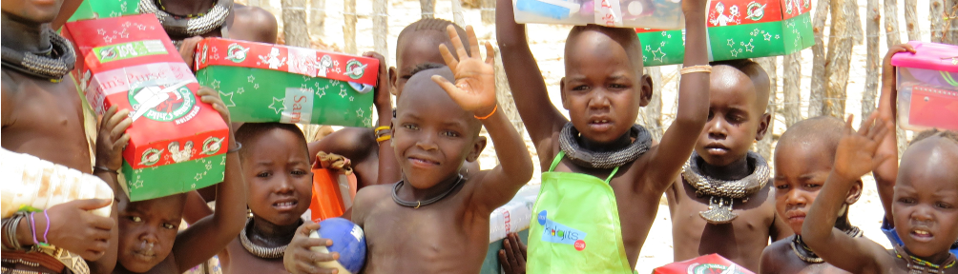
REACHING THE UNREACHED
MINISTRY PARTNERS DELIVER SHOEBOX GIFTS TO HARD TO REACH PEOPLE GROUPS ALL OVER THE WORLD.
Notes:
Slide time: 2 minutes
Another priority of Samaritan’s Purse is sharing the Good News where it has never been heard.
OCC is reaching communities hard to reach through bringing shoebox gifts and the message of the Gospel to more than hundreds of hard to reach ethnic groups. OCC’s goal is to share the Gospel with an exponential amount of hard to reach people groups in the coming year.
One example of this is the Himba people in Namibia, where this picture on the slide was taken. Samaritan’s Purse partnered with the Seed Company, an affiliate of Wycliffe Bible Translators, to translate more than 80 Bible stories, including the entire Gospel of Mark, as well as The Greatest Journey.
Since the Himba have a predominantly oral culture, these stories were distributed on hundreds of solar-powered MP3 players. Nearly 50 of the Himba shoebox recipients completed the 12 lessons of The Greatest Journey and, now, there is a continuously growing number of believers among this hard to reach community!

Slide 15
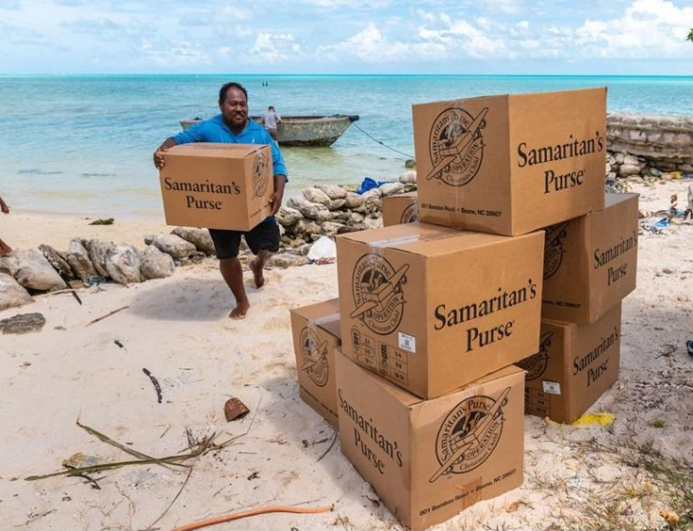
MULTIPLICATION
Notes:
Slide time: 1 minute
Another exciting way we are reaching the corners of the earth is through the Pacific Islands Initiative. OCC plans to deliver gift-filled shoeboxes to thousands of boys and girls on the Pacific islands within the coming years. Going island to island with the Gospel, we will work to introduce children to Jesus Christ.
We plan to share the love of Christ with thousands of children in the Pacific Islands.

Slide 16
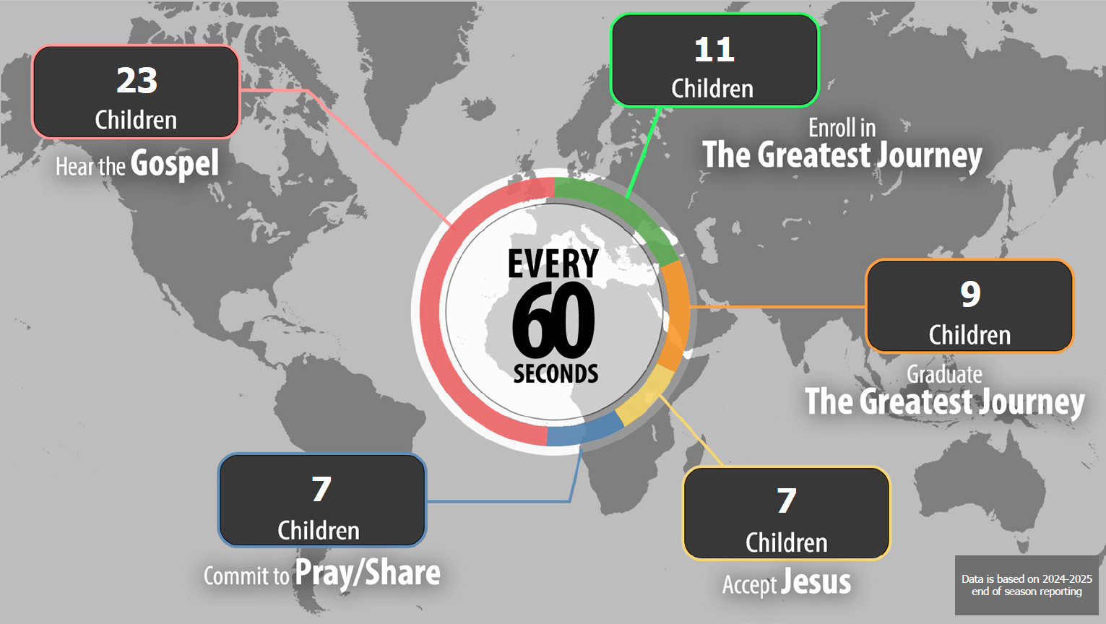
Notes:
Slide time: 1 minute
Every minute on average..
23 children hear the Gospel every minute.
7 children accept Jesus every minute – that’s one child deciding to follow Jesus every 15 seconds!
So, during our time together today for this hour, on average 420 children made decisions for Christ, 540 graduated from The Greatest Journey and 1,380 children heard the Gospel at a shoebox outreach event.
God is using this Ministry in powerful ways!

Slide 17
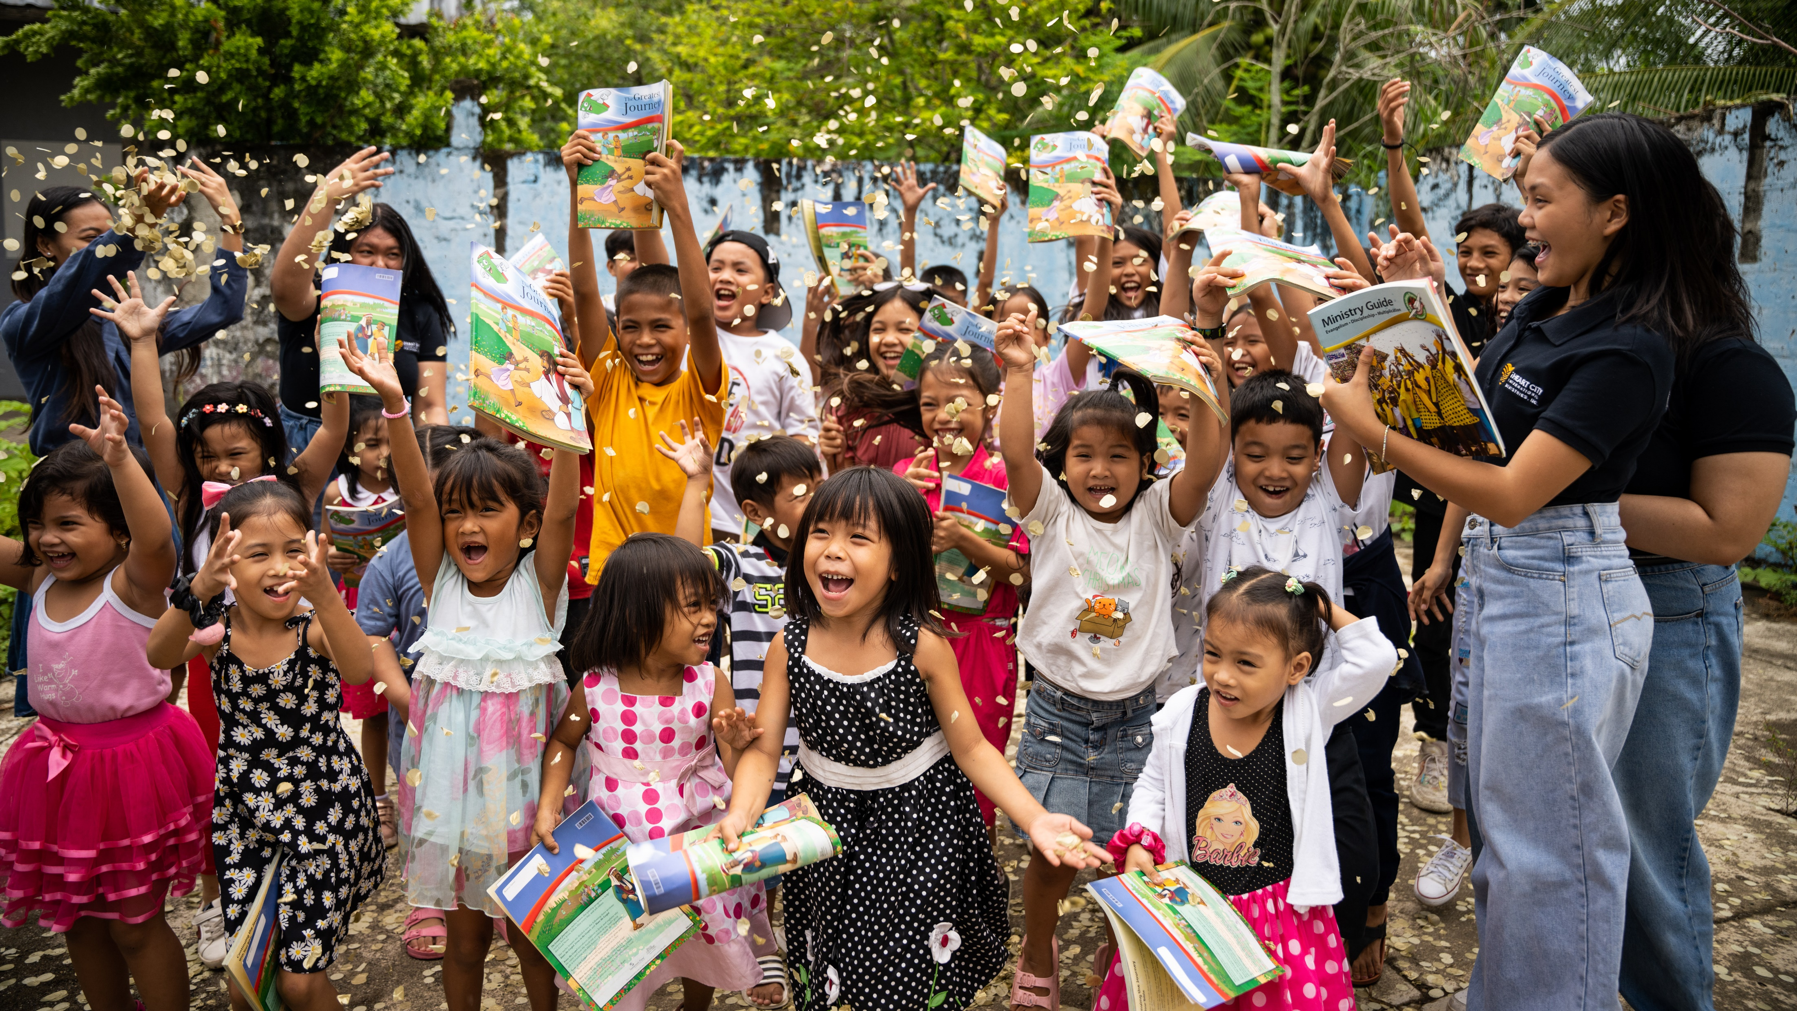
Notes:
Slide time: 1 minute
The statistics we just went over show how effective Operation Christmas Child is evangelism, discipleship and multiplication!
We read in Matthew 14 about Jesus’ return: “And this Gospel of the kingdom will be preached in the whole world as a testimony to all nations, and then the end will come.”
By participating in Operation Christmas Child, can you believe that we get to be a significant part of ushering the return of Jesus!

Slide 18
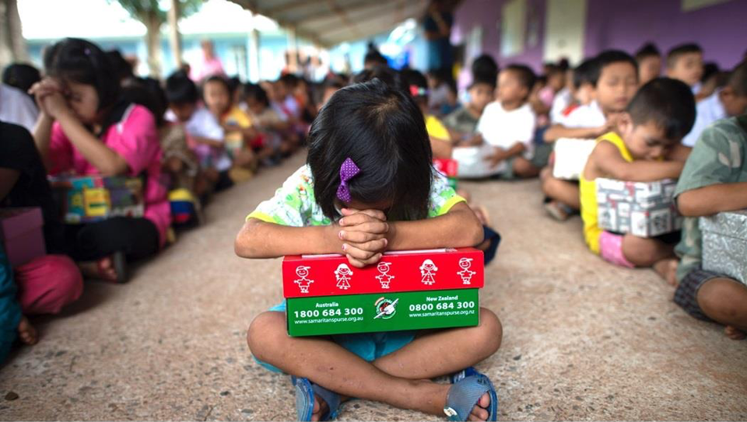
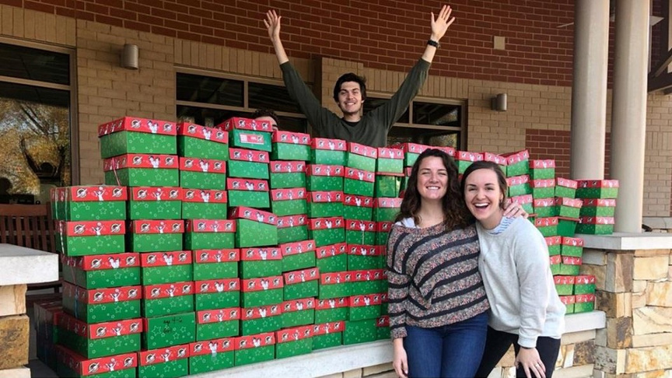
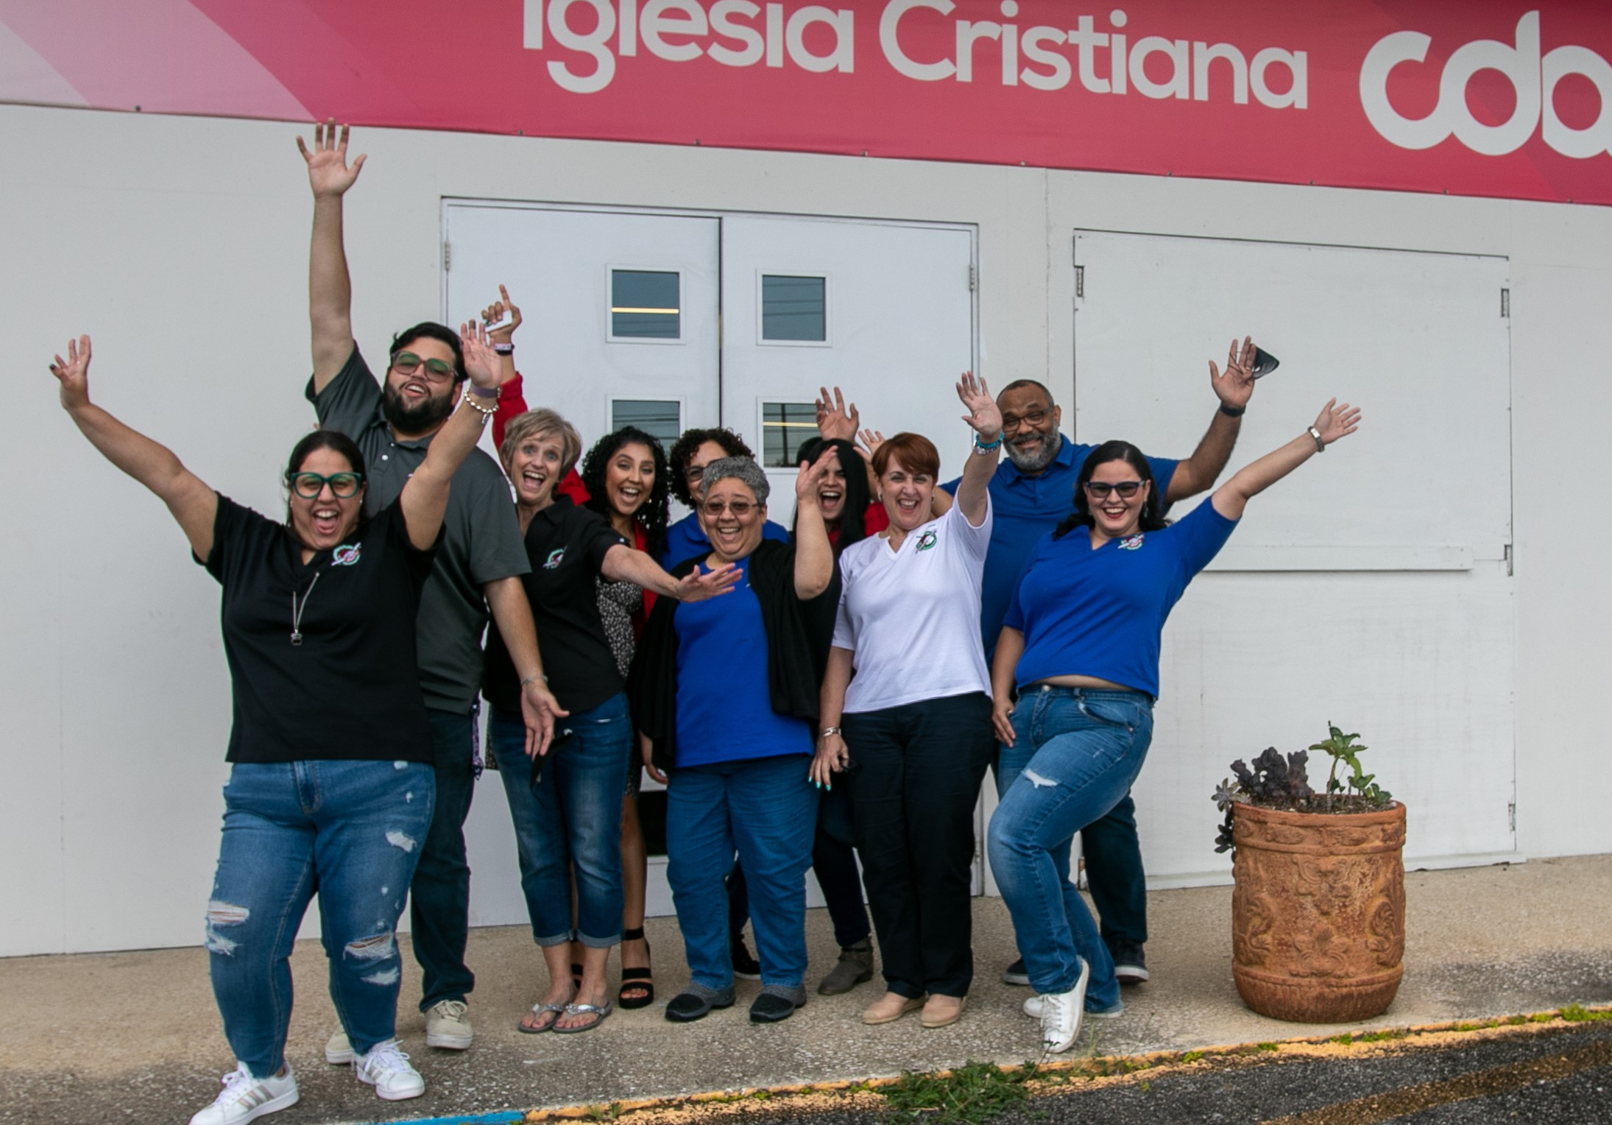
HOW YOU CAN
GET INVOLVED
PACK MORE SHOEBOXES
CONSIDER PARTNERING
PRAY
Notes:
Slide time: 2 minutes
It’s pretty incredible to see how God is using Operation Christmas Child to advance the Great Commission through evangelism, discipleship and multiplication.
So, what has stood out to you as we’ve shared about the impact of Operation Christmas Child?
* Affirm their answers and marvel together at how God is at work through OCC. If in a large group setting, choose a few people to respond.
With all that God is doing around the world through Operation Christmas Child, I’m sure you are asking, “How can I be involved?!”
I want to encourage you today to:
Pray for the Ministry
Pack more shoebox gifts
Consider Partnering as a year-round volunteer

Slide 19
PRAY
OPERATION CHRISTMAS
CHILD
PACK
PARTNER
Notes:
Slide time: 1 minute
First, I want to encourage you to pray for the Ministry of Operation Christmas Child!
Your prayers are vital in sharing the love and hope of Christ with children, their families and their communities in hundreds of countries around the world.
“Prayer is the foundation of our Ministry.”

Slide 20
PRAY
OPERATION CHRISTMAS
CHILD
PACK
PARTNER
Notes:
Slide time: 2 minutes
Second, pack shoebox gifts! Pack with your family, with your church or Bible study group, with your community groups or neighbors. Be creative – each gift has such a powerful impact on the child receiving it!
* As the presenter, share why you personally pack shoebox gifts and the impact it has on you and your family.

Slide 21
PRAY
OPERATION CHRISTMAS
CHILD
PACK
PARTNER
Notes:
Slide time: 4 minutes
The third way you can join in what God is doing around the world through Operation Christmas Child is by partnering as a year-round volunteer.
God is activating volunteers in amazing ways to move ministry forward in their communities so that more children will have the opportunity to hear the Good News and receive great joy through a shoebox gift.
Becoming a year-round volunteer, is an exciting way to fulfill God’s purpose for your life and answer His Great Commission calling!
Area Teams gather people together who love this ministry and want to make a significant Kingdom impact.
As our Area Teams multiply, we are able to provide a greater focus in our local communities for OCC, build relationships with churches and community groups, and unite the Body of Christ. The result is more shoeboxes and more Gospel opportunities!

Slide 22
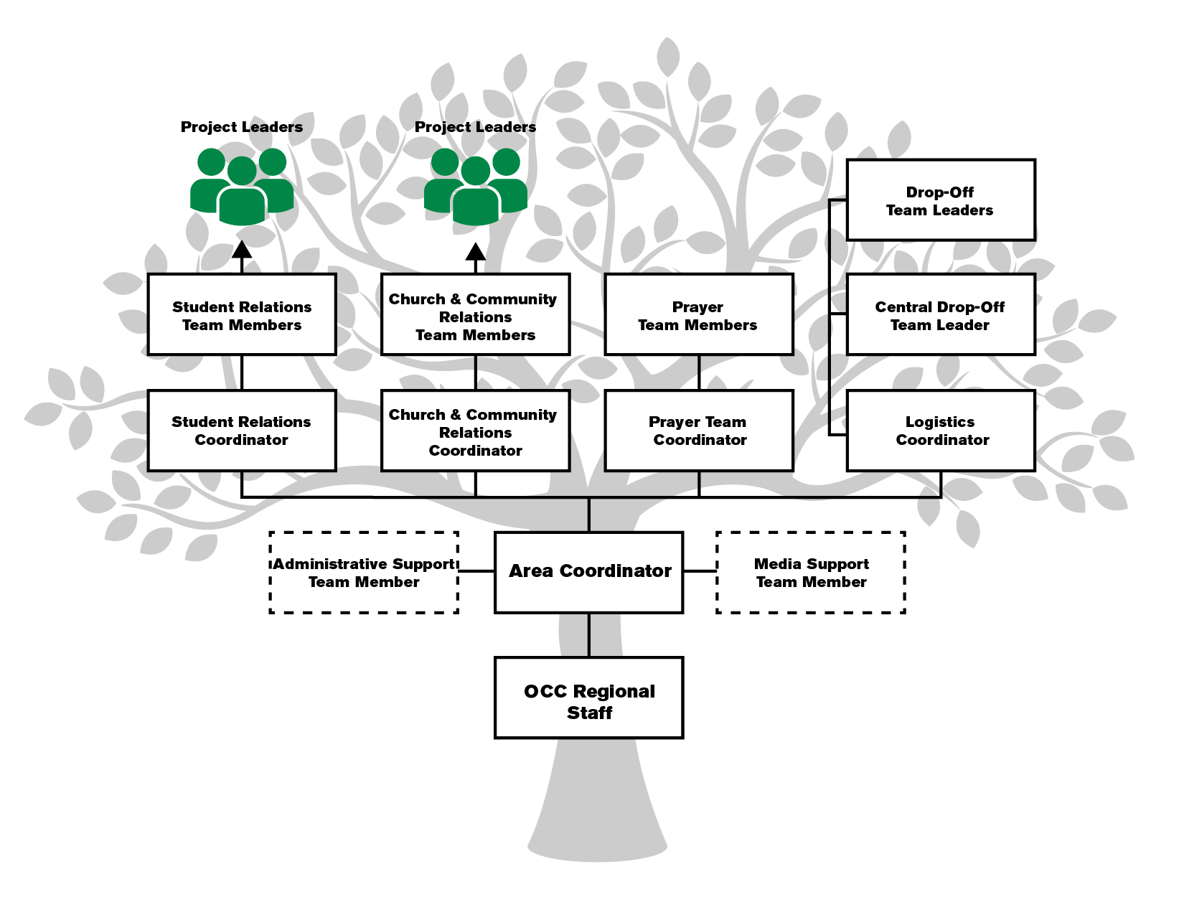
Notes:
Slide time: 1 minute
This is picture of a fully-functioning and effective Area Team.
This shows the strength an Area Team has together, with our roots deep in Christ, as Colossians 2:7 says, “Let your roots grow down deep into Him, and let your lives be built on Him. Then your faith will grow strong in the truth…”
You can see that this growth chart shows the function of a Coordinator as a Team Builder. Again, OCC Leader Volunteers build and lead teams of people (Area Coordinators and Ministry Coordinators who are Team Builders) who build and lead teams of people (Team Members) who mobilise shoeboxes through prayer, promotion and a healthy logistics network. These Team Members are the vibrant expression of activated ministry that is powerful and effective. They reach children around the nations by building relationships with Project Leaders and individuals who pack shoeboxes!
As the Area Team grows, the branches reach out further and further, as shoebox gifts reach children to the ends of the earth with the Gospel and God’s love.
This is Kingdom FRUIT!
I serve as a ____________ on my Area Team.
* Share a personal testimony about why you love serving on the Area Team
* Share the vision for your Area Team and the need on your team for fulfilling that vision. Example: “Over the next few years, we anticipate growing our Drop-off Network from ___ to ___ Drop-Off Locations, developing a strong and active prayer team, and engaging all churches in the area to participate in OCC – we think that this will double the amount of shoeboxes for our area. That would be ____ boys and girls ANNUALLY who would hear about the Good News of Jesus Christ. Yes, just out of this area! Would you pray about joining the team in this effort?”
* Use this Growth Chart to highlight needs on your Area Team

Slide 23
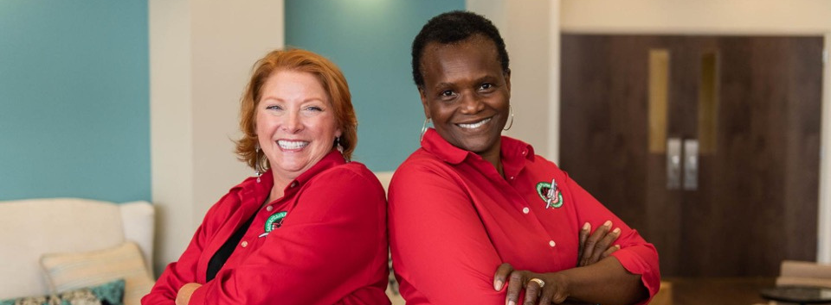
AREA TEAMS
AREA TEAMS MOBILISE PEOPLE AND MULTIPLY SHOEBOX GIFTS
Notes:
Slide Time: 1 minute
As a part of the Area Team, you will mobilise people and multiply shoebox gifts.
It is a blessing to have such a vital role in what the Lord is doing here and overseas.
We can be missionaries at home in our communities, and have an incredible impact in reaching children all over the world with God’s love through Operation Christmas Child.

Slide 24
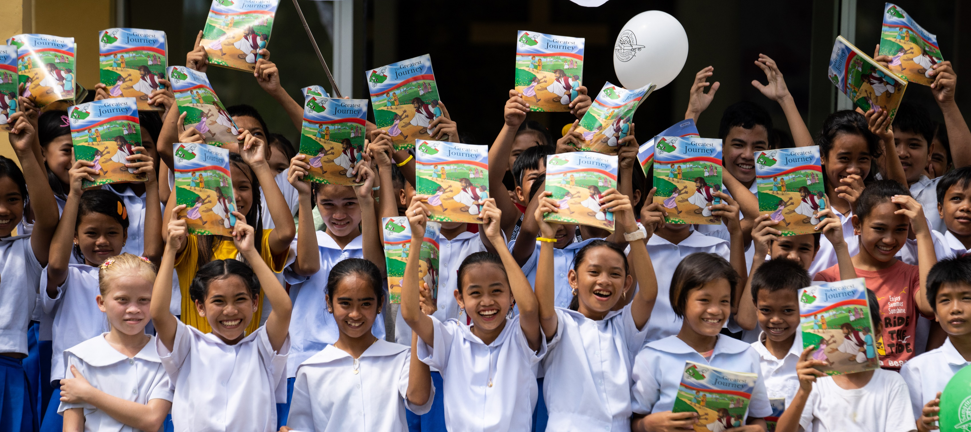
EVERY CHILD MATTERS
EVERY SHOEBOX MATTERS
Notes:
Slide time: 2 minutes
Every single shoebox packed makes a difference!
Here is just one of the millions of testimonies from around the world:
Nahimana lives in Burundi, and he admits he wasn’t a good father. In his words, “I didn’t deserve to be called a father because I was frequently drunk. My wife and my children slept hungry many times.” Sadly, they didn’t have proper clothing.
One day Nahimana’s son came home with a shoebox gift and a small booklet called The Greatest Gift.
Unbeknownst to his family, Nahimana began to read The Greatest Gift in secret, and wondered what it was all about. His son started The Greatest Journey discipleship program, and came home and told his parents what he was learning about Jesus. He graduated and brought his new Bible home.
Nahimana then began reading this Bible, and God opened His heart. This broken father received Christ! As his wife saw the transformation in his life, she joined her husband in trusting in Jesus. The entire family became Christians and are now serving the Lord!
What a wonderful example of how a life and a family can be changed by one single shoebox gift! Every shoebox matters, because every child and every family matters to God.

Slide 25
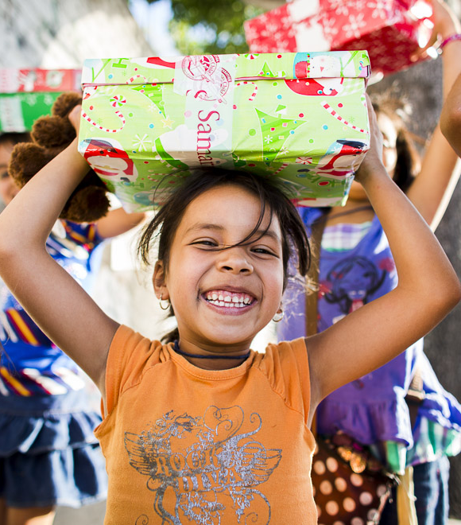
MATTHEW 9:37-38
Then He said to His disciples, “The harvest is plentiful but the workers are few. Ask the Lord of the harvest, therefore, to send out workers into His harvest field.”
Notes:
Slide time: 3 minutes
Jesus said to His disciples, and He says to us today, “The harvest is plentiful but the workers are few. Ask the Lord of the harvest, therefore, to send out workers into His harvest field.”
Will you answer His call? Please pray with us as we seek those who God is calling to join us in reaching children around the world with God’s love through shoebox gifts!
* If in a one-on-one conversation, ask these questions:
Do you feel like the Lord is calling you to go through the selection process?
As we talked about partnering on the year-round Area Team, did any of the opportunities catch your attention and heart (Affirm and discuss their answer)?
* If in a large group setting, say:
How may God be calling you to join us in mobilising people and multiplying shoebox gifts?
Would you pray about your next step of partnership with OCC?
I want to encourage you to seek the Lord, and ask Him how He may be leading you to be involved with Operation Christmas Child.
Please come speak with me or anyone here from the Area Team to talk more about how you can partner with OCC!
* Make a follow-up plan with this person if in a one-on-one recruitment meeting, or share the next step with the group if they are interested in learning more – such as talk to me after the presentation, meet me at this area to connect, etc.

Slide 26
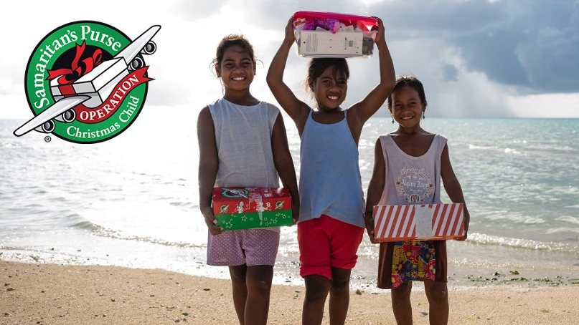
GOOD NEWS. GREAT JOY!
Notes:
Slide time: 1 minute
Thank you for spending this time with me today learning more about Operation Christmas Child and how your shoebox gifts are changing the lives of children through Good News and Great Joy! And, thank you for considering your next step of partnership!
Let’s pray to close.
* Presenter prays

